Slide 1
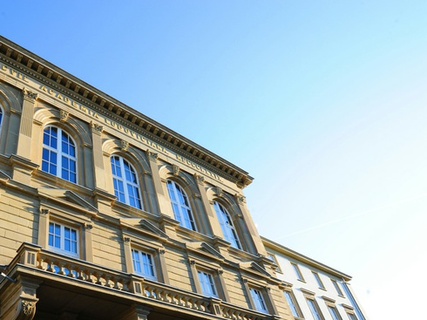



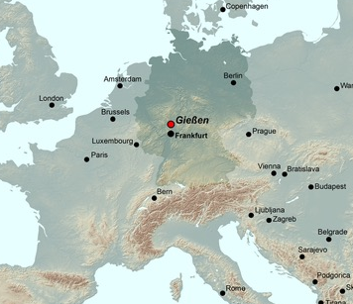
Geomorphology and Quaternary Sciences:
Connecting disciplines
Giessen/Germany
23. - 27. September 2018
Welcome to Giessen
www.uni-giessen.de/Giessen2018
Notes:
1

